Slide 1
Topics
Introduction & Data Overview
Objectives & Process
Analysis (Part 1)
Analysis (Part 2)
Insights
Recommendations
Dashboard, Conclusion, and Challenges

Slide 2
Introduction to Manufacturing Analysis
Manufacturing analysis involves examining key production metrics to improve efficiency, reduce costs, and optimize resource utilization.
This dataset provides detailed records of work orders, production quantities, employee assignments, and machine usage, making it ideal for assessing manufacturing performance and productivity.
This report presents an analysis of manufacturing performance, utilizing the dataset that captures detailed records of production processes, employee involvement, machine utilization, and work order management.
The dataset provides a comprehensive view of key production metrics across multiple dimensions, such as customer orders, work order tracking, employee assignments, and machine performance.

Slide 3
Data Overview
The dataset used for this manufacturing analysis contains 10,618 records and 68 columns, capturing key aspects of the production process, including work orders, machine performance, employee involvement, and customer deliveries. The data provides a comprehensive view of manufacturing operations, making it valuable for analyzing efficiency, productivity, and cost management.
Dataset Structure:
Customer and Order Information:
Cust Code, Cust Name: Identifies customers placing manufacturing orders.
Delivery Period, SO Delivery Date: Tracks delivery timelines and order fulfillment efficiency.
SAP So Num, SO Num: Represents order numbers used for tracking.
Production Process Details:
Item Code, Item Name: Identifies the products being manufactured.
Manufactured Qty, Processed Qty, Produced Qty, Rejected Qty: Tracks production output and defect rates.
Final Processed Qty, Balance Qty: Measures work order progress and remaining tasks.

Slide 4
Data Overview
Employee and Machine Utilization:
Emp Code, Emp Name: Associates production tasks with specific employees.
Machine Code, Machine Name: Identifies the machines used in production.
Per Day Machine Cost Made: Provides cost analysis related to machine usage.
Work Order Tracking:
WO Number, WO Date, WO Status: Captures work order details, including dates and status.
WO Qty, Total Qty: Defines total work order volume and production targets.
This dataset serves as a foundation for understanding manufacturing efficiency, identifying bottlenecks, and optimizing processes for better productivity and cost-effectiveness.

Slide 5
Objective
The primary objective of this dataset is to analyze and optimize manufacturing operations by tracking production efficiency, resource utilization, and work order management.
Key Objectives:
Production Performance Evaluation
Work Order Management
Machine and Resource Utilization
Quality Control & Defect Analysis
Financial and Cost Analysis
By Utilizing this dataset, businesses can improve decision-making, operational efficiency, and cost savings, ultimately enhancing overall manufacturing performance.

Slide 6
Process
Data Preparation & Cleaning
Check for Missing Values.
Identify and handle missing or blank fields
Standardize Data Types
Ensure numeric columns
Convert date column in proper datetime format.
Remove Duplicates
Data Transformation in Power Query
Rename columns for better readability.
Remove unnecessary columns that are not required for the dashboard
Creating Relationships & Data Model
Building the Dashboard

Slide 7
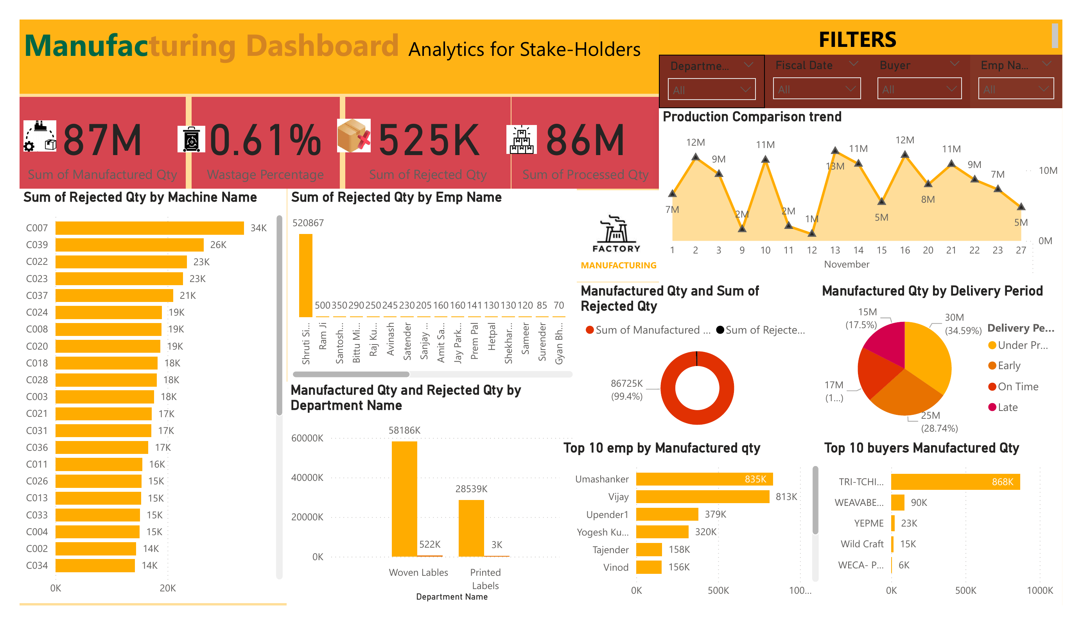
Dashboard Overview

Slide 8
Analysis (Part 1):- Key Metrics Overview
- Sum of Manufactured Qty: 87M
- Sum of Rejected Qty: 525K
- Sum of Processed Qty: 86M
- Wastage Percentage: 0.61%
- Avg. Manufactured Qty per Period: 8.17K
- Avg. Rejected Qty per Period: 49.42
Analysis:
The company has manufactured 87 million units, out of which 525K were rejected.
The rejection rate (0.61%) is relatively low, which indicates good production efficiency.
The processed quantity (86M) suggests that most of the manufactured items successfully passed quality checks

Slide 9
Employee Performance Analysis
Sum of Rejected Qty by Employee Name
Employees such as Shruti, Ram Ji, Santosh, Bittu, and Raj Ku have the highest rejected quantities.
Some employees have lower rejection counts (e.g. Hetpal, Shekhar, Sameer)
Top 10 Employees by Manufactured Qty
Uma shanker (835K) and Vijay (813K) are the top-performing employees in terms of production.
Other employees (Upender1, Yogesh Ku, Tajender) also contribute significantly.
Analysis:
Employees producing high quantities should be analyzed for quality control.
Some employees might need additional training to reduce rejected quantities

Slide 10
Machine Performance Analysis
Sum of Rejected Qty by Machine Name
Machines C007, C039, C022, C023, and C037 have the highest rejected quantities.
Machines with fewer defects might indicate better maintenance or calibration.
Analysis:
Machines with higher rejection counts may require maintenance or recalibration.
Predictive maintenance could help reduce rejection rates
Departmental Analysis
Manufactured Qty and Rejected Qty by Department
Woven Labels: 58.19M units manufactured, 522K rejected
Printed Labels: 28.54M units manufactured, 3K rejected

Slide 11
Analysis:
The Woven Labels department contributes the highest quantity but also has the most rejections.
Printed Labels have a much lower rejection rate, indicating a more stable production process.
Production Trend Analysis
Production Comparison Trend
The chart shows fluctuations in production quantity across different dates in November.
Peak production days (e.g., 13M, 11M) contrast with lower production days (e.g., 2M, 5M).
Analysis:
Identifying peak production days can help optimize workforce planning.
Lower production days should be investigated for potential issues (e.g., supply shortages, machine breakdowns

Slide 12
Analysis (Part 2):- Production Trends Over Time
Manufactured Quantity Comparison
Highest Production Period: Certain days in November saw peaks of 13M, 11M, and 12M units.
Lowest Production Period: Some days had significantly lower production, around 2M–5M units.
Overall Trend: Fluctuations suggest periodic spikes in production, possibly due to demand changes, machine availability, or workforce efficiency.
Analysis:
Production peaks could be linked to seasonal demand or increased workforce efficiency.
Lower production days might indicate machine breakdowns, supply chain issues, or low work shifts.

Slide 13
Buyer Analysis
Top 10 Buyers by Manufactured Qty
TRI-TCHIBO (868K)
WEAVABEL MUABA (90K)
Other buyers (YEPME, Wild Craft, WECA-P) have significantly lower orders.
Analysis:
The company is heavily reliant on one major buyer.
There is an opportunity to expand the buyer base to reduce dependency on a single client.
Delivery Performance
Manufactured Qty by Delivery Period
34.59% Under Production
28.74% Early
17.5% On Time
13

Slide 14
Analysis:
A significant portion of production is ahead of schedule, which is a positive indicator.
A focus on timely deliveries can help maintain customer satisfaction.
Woven Labels: 58.19M units, 522K rejected (High rejection rate).
- Printed Labels: 28.54M units, 3K rejected (Low rejection rate).
- Process improvement needed in Woven Labels.
Overall Key Takeaways
✅ Production Efficiency: Strong production numbers with minimal waste (0.61%).
⚠️ Employee Training: Some employees have high rejection rates and may need additional training.
⚠️ Machine Maintenance: Machines with high rejection counts should be checked for issues.
⚠️ Departmental Disparity: Woven Labels have higher rejection rates than Printed Labels.
⚠️ Buyer Dependence: Most orders come from a single buyer, posing a business risk.
✅ Good Delivery Management: Most deliveries are early or on time, minimizing delays.

Slide 15
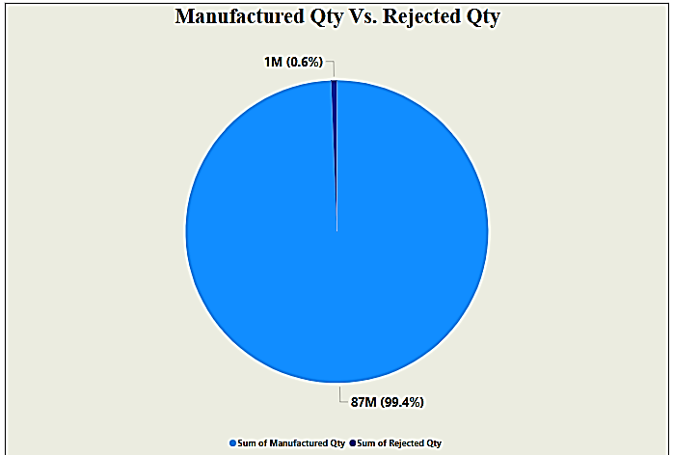
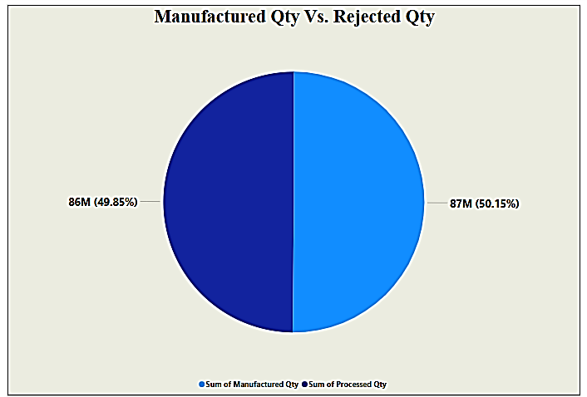
Insights :-
1. Production Efficiency:
Manufactured Quantity vs. Rejected Quantity: A significant insight can be drawn by comparing the total manufactured quantity with the rejected quantity. This can help in identifying production inefficiencies or quality issues.
Manufactured vs. Processed Quantity: This will give insights into how much of the produced items actually went through the required processing stages. It can highlight any gaps in processing or delays.

Slide 16

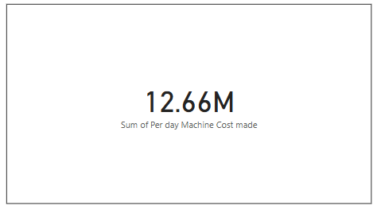
2. Work Centre Performance:
Machine / Employee Efficiency: Comparing the "Balance Qty" and "Processed Qty" against machine and employee names can give insight into how well each work center or employee is performing, allowing for performance optimization.
Per Day Machine Cost Made: Insights regarding costs per machine can help evaluate if certain machines are more expensive to operate than others, potentially identifying areas for cost-saving.

Slide 17
3. Delivery Timeliness:
Delivery Period & SO Delivery Date: By comparing delivery periods with actual delivery dates, you can gain insights into the accuracy and reliability of the delivery process. Delays or inconsistencies can be flagged for improvement.
4. Inventory Management:
Shortages vs. Manufactured Quantity: By analyzing shortages in relation to the manufactured quantity, insights can be drawn on whether shortages are due to production delays, inventory issues, or other operational constraints.

Slide 18
Recommendations for Data Management and Tracking Improvement
Implement Automated Data Collection & Integration:
Recommendation: Use automated data collection systems (such as IoT sensors and ERP integrations) to ensure that data such as Manufactured Qty, Rejected Qty, and Processed Qty is captured in real-time.
Benefit: This will minimize human errors, reduce manual tracking, and provide up-to-date insights into production trends.
Recommendations for Improving Production Efficiency and Quality Control
Focus on Root Cause Analysis for Rejected Qty and Wastage:
Recommendation: Use advanced analytics (such as Six Sigma or root cause analysis tools) to identify patterns in Rejected Qty, Wastage Qty, and Employee Wise Rejected Qty.
Benefit: Pinpointing specific causes (e.g., certain operations, machines, or employees) allows for targeted process improvements, leading to reduced rejection rates and lower wastage.

Slide 19
Conclusion
The analysis of the manufactured, rejected, and processed quantities highlights areas for improvement in both quality control and process efficiency. A high rejection rate, particularly at the machine or employee level, suggests potential issues with equipment performance or skill gaps that could be addressed through targeted training or maintenance. Additionally, a significant amount of wastage points to inefficiencies that could be reduced with better material management or process adjustments. The departmental breakdown of manufacturing versus rejections enables targeted interventions in specific areas, improving overall output quality. Tracking production trends over time will allow for identifying patterns and making proactive adjustments to optimize both manufacturing and quality.

Slide 20
Challenges in Data Accuracy and Reporting
Data Integrity and Consistency
Ensuring data consistency across various sources (e.g., Manufactured Qty, Rejected Qty, Processed Qty) can be difficult.
Inconsistencies in the Fiscal Date, Doc Date, or Machine-wise data may lead to inaccurate reporting.
Complexity in Integrating Multiple Metrics
Employee-wise and Machine-wise data can be overwhelming to manage, as this requires integrating and analyzing data from various sources.
Ensuring that values like Per day Machine Cost or Balance Qty are calculated correctly can be challenging.
Lack of Real-Time Insights
Real-time production tracking is difficult with a large volume of transactional data (Item Code, Machine Name, etc.), leading to potential delays in identifying issues like wastage or rejected quantities.
Data Overload
The sheer amount of data (e.g., SO Numbers, Shift Codes, WO Numbers) can cause analysis paralysis, making it hard to focus on key performance indicators.

Slide 21
Operational Challenges in Production and Quality Control
Quality Control and Rejections
Managing Rejected Qty and understanding the reasons for Employee-wise and Machine-wise rejections can be time-consuming and resource-intensive.
Aligning with the Is Final Process and Shortages can lead to inefficiencies in tracking defective or incomplete products.
Resource Allocation
Difficulty in effectively managing employee allocation and machine utilization (e.g., Machine Code, Shift Code) can result in unproductive hours and increased costs.
Department-wise production comparisons and managing individual worker efficiency is often challenging

Slide 22
Production Bottlenecks
Identifying production bottlenecks through trends like Production Comparison trend can be complex due to the many variables involved (Machine Code, Operation Code, Emp Code).
Tracking the WO Qty against production targets and delivery deadlines is essential but can often face delays due to equipment downtime or human errors.
Forecasting and Scheduling
Challenges in forecasting demand and production timelines, leading to the inability to meet SO Delivery Dates or SO Expected Delivery times.
Today Manufactured Qty and TotalQty may not always align with forecasts due to unforeseen events such as machine breakdowns or labor shortages.

Slide 23
Thankyou

